Slide 1
Software Analysis and Design (CS:3004)
Timing Diagram

Slide 2
Timing Diagram:
A timing diagram in the Unified Modeling Language is a specific type of interaction diagram, where the focus is on timing constraints.
It is used to explore the behaviors of objects throughout a given period of time.
A timing diagram is a special form of a sequence diagram. The differences between timing diagram and sequence diagram are the axes are reversed so that the time increases from left to right and the lifelines are shown in separate compartments arranged vertically.
The timing diagram is available since UML version 2.0 and includes elements such as message, lifeline, timeline, and object or role.

Slide 3
Timing Diagram:
Timing diagrams are a type of interaction diagram that emphasize detailed timing specifications for messages. They are often used to model real-time systems such as satellite communication or hardware handshaking.
They have specific notation to indicate how long a system has to process or respond to messages, and how external interruptions are factored into execution.
Unlike sequence diagrams, timing diagrams are read left to right rather than top to bottom.

Slide 4
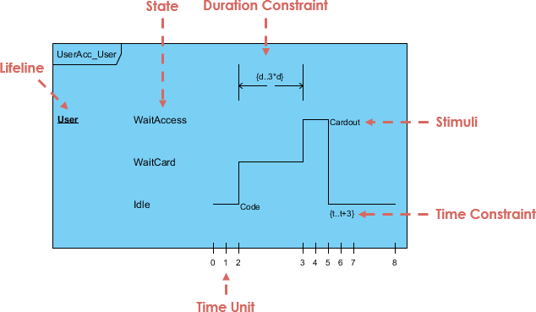
UML Timing Diagram: (Robust Notation)
robust: A complex line signal designed to show the transition from one state to another (can have many states).

Slide 5
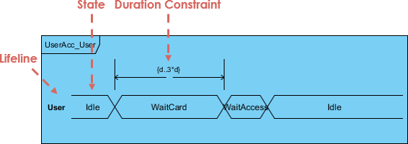
Alternative notation of UML Timing diagram: (Concise Notation)
Concise: A simplified signal designed to show the movement of data (great for messages).

Slide 6
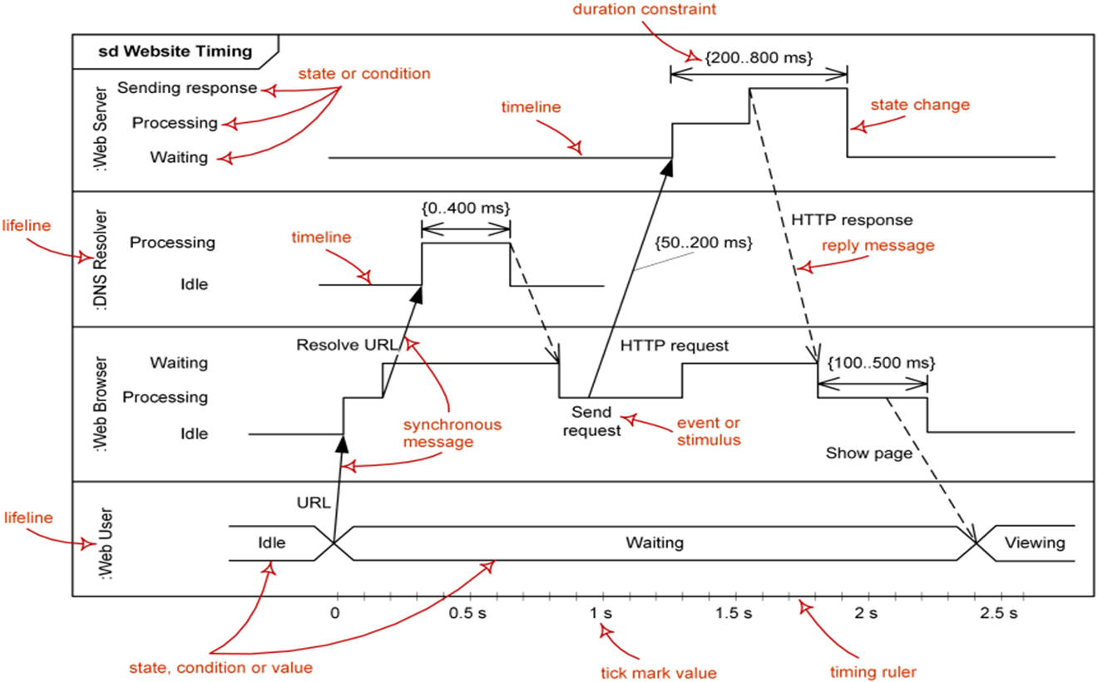
Major elements of timing UML diagram:

Slide 7
Frame/Interaction
The notation shows a rectangular frame around the diagram with a name in a compartment in the upper left corner

Slide 8

Lifeline: (full shape/ compact shape)
There are two types of lifelines to show the lifeline of the components
Lifeline is a named element which represents an individual participant in the interaction.
Lifeline on the timing diagrams is represented by the name of classifier or the instance it represents. It could be placed inside diagram frame or a "swim lane".

Slide 9
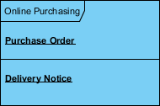
Continue…
Multiple lifelines may be stacked within the same frame to model the interaction between them.

Slide 10
Lifeline (full shape/ compact shape)

Slide 11
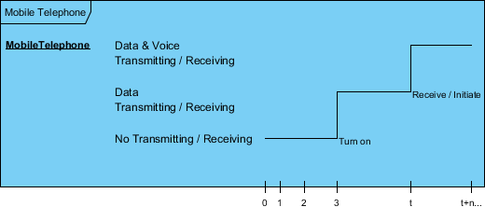
State Timeline:
A state or condition timeline represents the set of valid states and time. The states are stacked on the left margin of the lifeline from top to bottom.

Slide 12
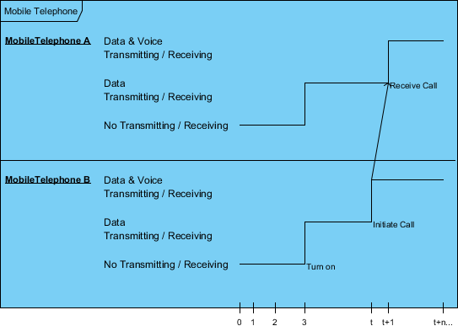
Multiple Compartments:
It is possible to stack several lifelines of different objects in the same timing diagram. One lifeline above the other. Messages sent from one object to another can be depicted using simple arrows. The start and the end points of each arrow indicate when each message was sent and when it was received.

Slide 13
Synchronous Message/ Reply Message
Messages show interaction among diff lifelines. Message is represented as filled arrow and reply as unfilled arrow

Slide 14
Timeline and Constraints:
We can use the length of a timeline to indicate how long the object remains in a particular state by reading it from left to right. To associate time measurements, you show tick marks online the bottom part of the frame.

Slide 15
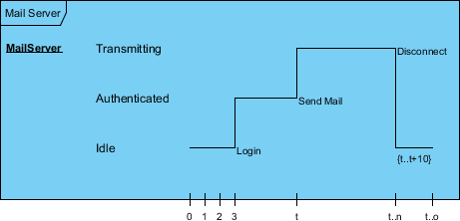
Continue…
The example below shows that the Login event is received three-time units after the start of the sequence. To show relative times, you can mark a specific instance in time using a variable name. The figure marks the time the sendMail event is received as time

Slide 16
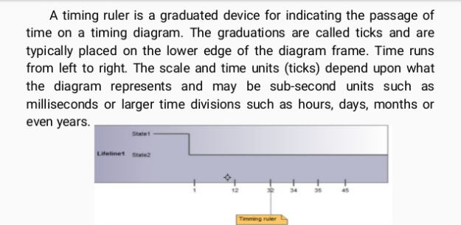
Timing Ruler:

Slide 17
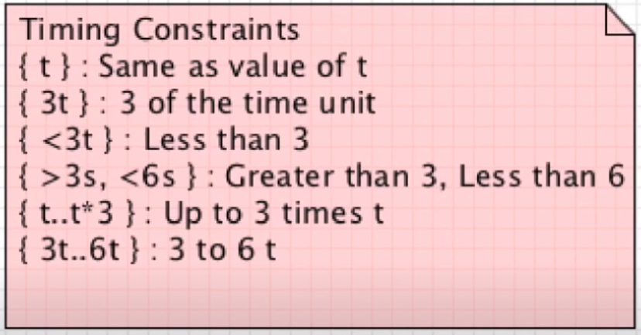
Timing constraints

Slide 18
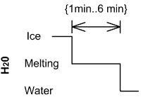
Duration Constraint:
Duration constraint is an interval constraint that refers to a duration interval. The duration interval is duration used to determine whether the constraint is satisfied.
Ice should melt into water in 1 to 6 minutes

Slide 19

Time Constraint
Time constraint is an interval constraint that refers to a time interval. The time interval is time expression used to determine whether the constraint is satisfied.
Person should wake up between 5:40 am and 6 am

Slide 20
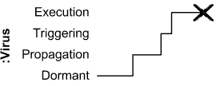
Destruction Occurrence:
Destruction occurrence is a message occurrence which represents the destruction of the instance described by the lifeline. It may result in the subsequent destruction of other objects that this object owns by composition. No other occurrence may appear after the destruction event on a given lifeline.
Notation: The destruction event is depicted by a cross in the form of an X at the end of a timeline.

Slide 21
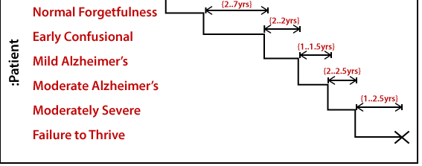
A timing diagram example of a medical domain that depicts different stages of Alzheimer's disease (AD) is explained below.

Slide 22


Slide 23
1. Find the states
1. Customer Inserts Card
1A. Card is Invalid
1B. Eject Card
2. Card is Validated
3. Customer Enters PIN
3A. PIN is Invalid
3B. PIN is Invalid 3 Times
3C. Card Marked as Stolen
4. PIN is Validated
5. Account is Selected
6. Amount is Selected
6A. Over Daily Maximum
6B. Over Account Funds Available
6C. Over Funds in Machine
6D. Ask for New Amount
7. Provide $10 or $20
8. Provide Funds
Provide Receipt
10. Eject Card

Slide 24
2. Find the participants
Customer
ATM/Card reader
Server/BankAccountDB

Slide 25
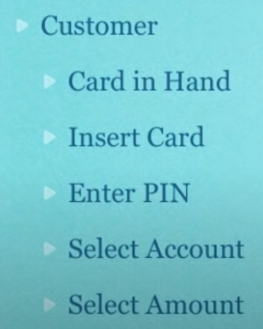
3. Match the states to participants

Slide 26
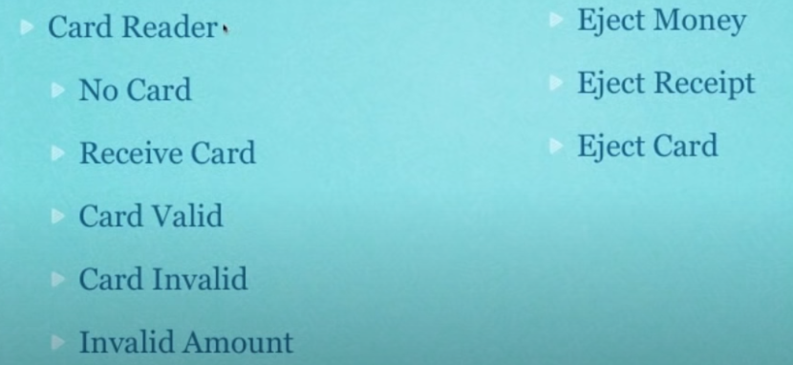
3. Match the states to participants

Slide 27
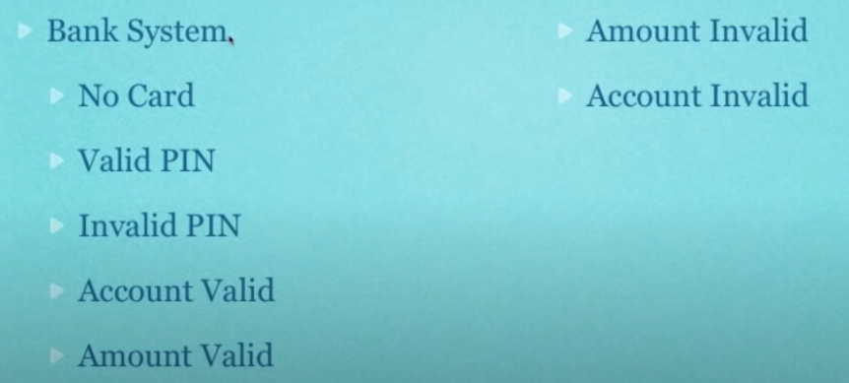
3. Match the states to participants

Slide 28
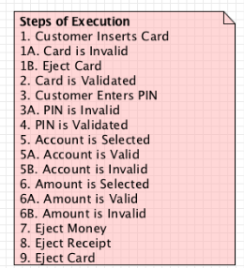

Slide 29
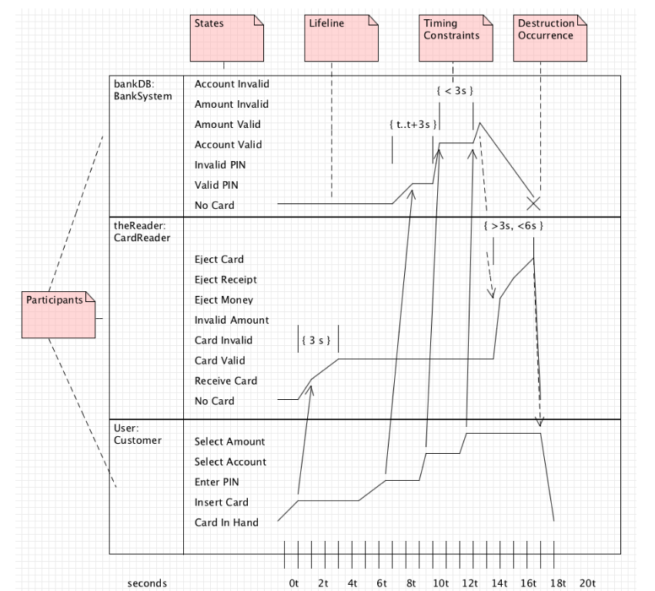

Slide 30
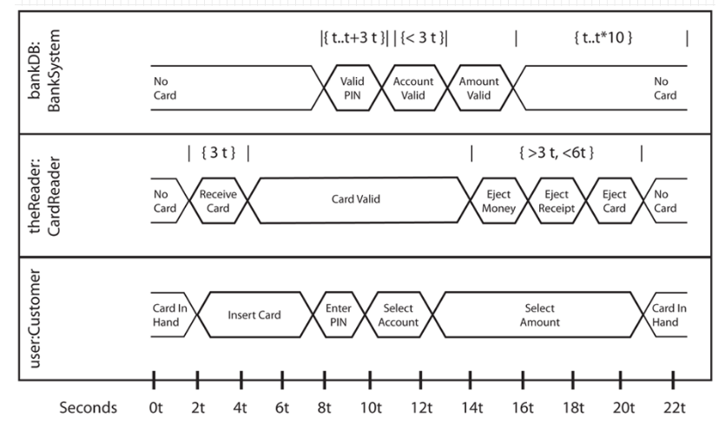

Slide 31
Scenario:
Part of the lift specification used in this scenario. The requirements maybe described “...A part of the lift system contains two objects: the floor sensor and the lift. The lift movement states are separated into three steps: moving up(2), stop at floor and moving down(1). The floor sensor has two states: on and off. The relation between the lift movement and the floor sensors means a user presses a button to request the lift from floor 1, the lift starts moving down from the current floor; lift must be arrive at requested floor within between 2 – 5 seconds after the lift starts moving, the floor sensor of the current floor will turn off within given time frame .”
:FloorSensor on
off {2s..5s}
:Lift MovingUp
StopAtFloor
MovingDown {2s..5s}

